Slide 1
CPSC474 Final Project -
Tree Election
Duy Do
12/07/2019

Slide 2
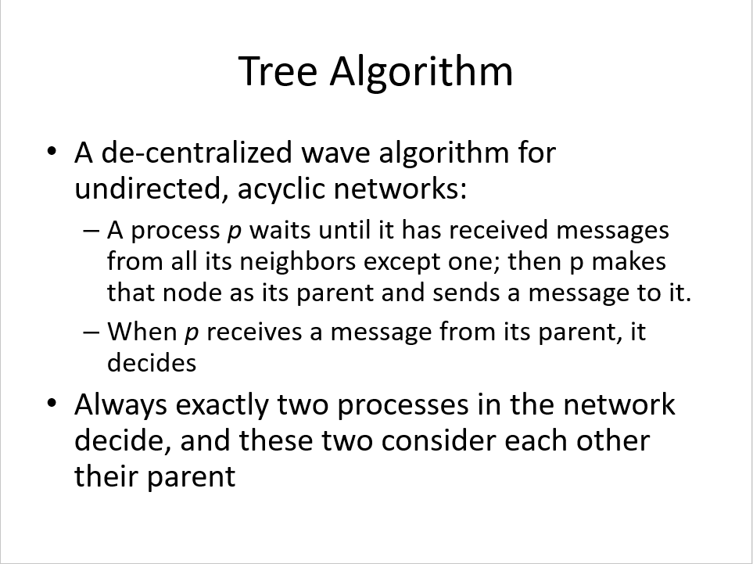
Tree Election
Motivation ?
I like the asynchronous aspect of the algorithm and thought it would be cool to simulate it.
Able provide Reliable Message Delivery with via MPI blocking communication and not stall the program.

Slide 3
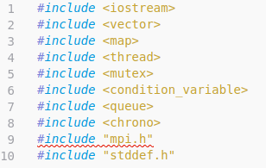
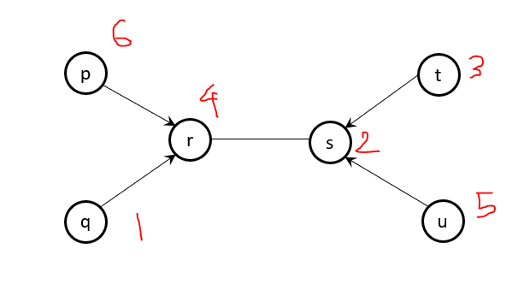
Setup
Language: C++ 11
MPI version: 3.2
Docker: https://hub.docker.com/r/nlknguyen/alpine-mpich/

Slide 4
Design
7 Processes(Class Node) each has 3 threads
Receive Thread - Accept Message (Struct Message) from other processes (Node).
Receive Queue
Send Thread - Send Message (Struct Message) to other processes (Node)
Send Queue
Process Thread - Process accepted Messages.
Receive Queue
Class Node (******WRAPPER CLASS)
Struct Message
Enum Message_Type
End - 0
WakeUp - 1
Control - 2
Announce - 3
Invalid_Type -4

Slide 5
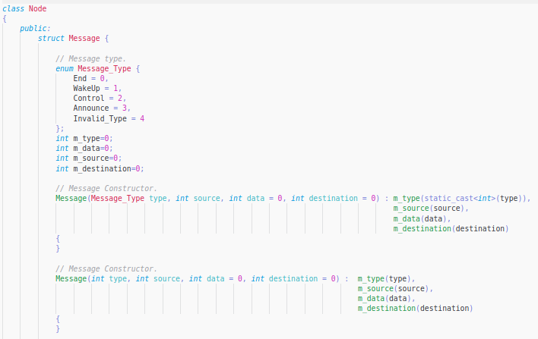
Class Node - Public Struct Message

Slide 6
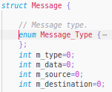
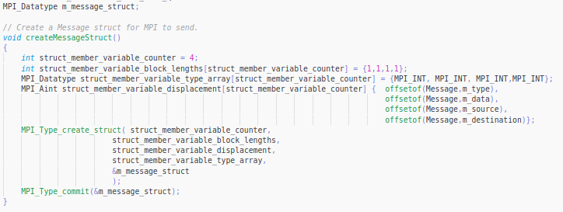
Send Struct Message via MPI

Slide 7
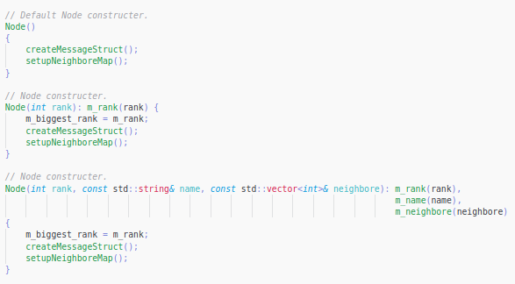
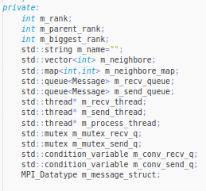
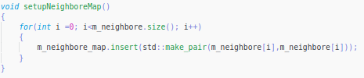
Class Node - Constructor & Member Variables

Slide 8

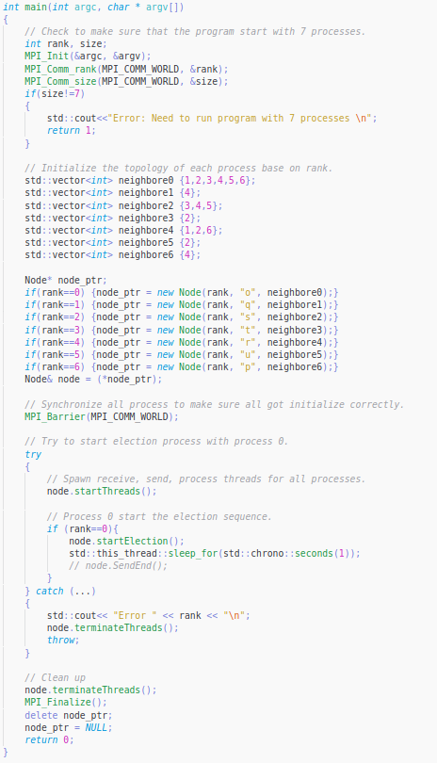
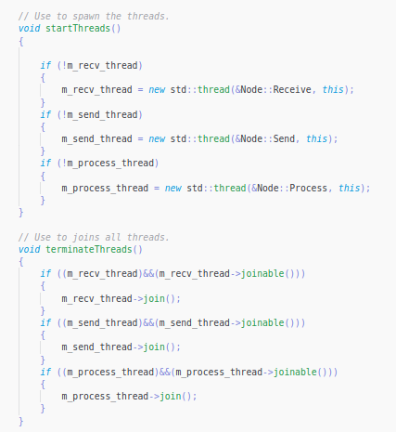
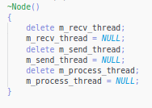
Node and Thread Setup

Slide 9
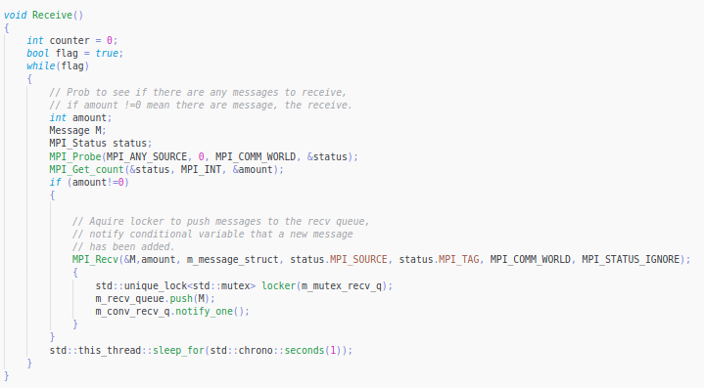
Receive Thread
Used to prevent busy waiting

Slide 10
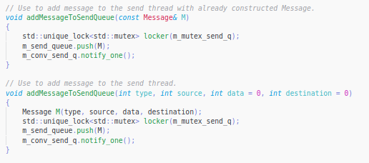
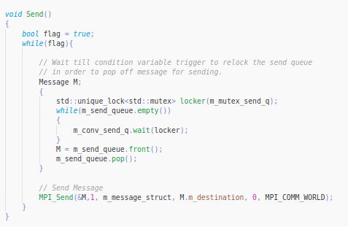
Send
Used to prevent busy waiting

Slide 11
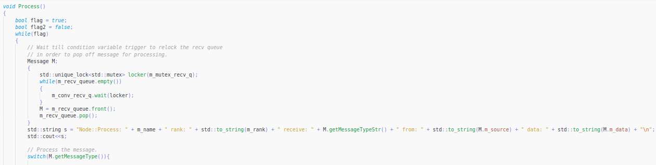
Process Thread
Used to prevent busy waiting

Slide 12
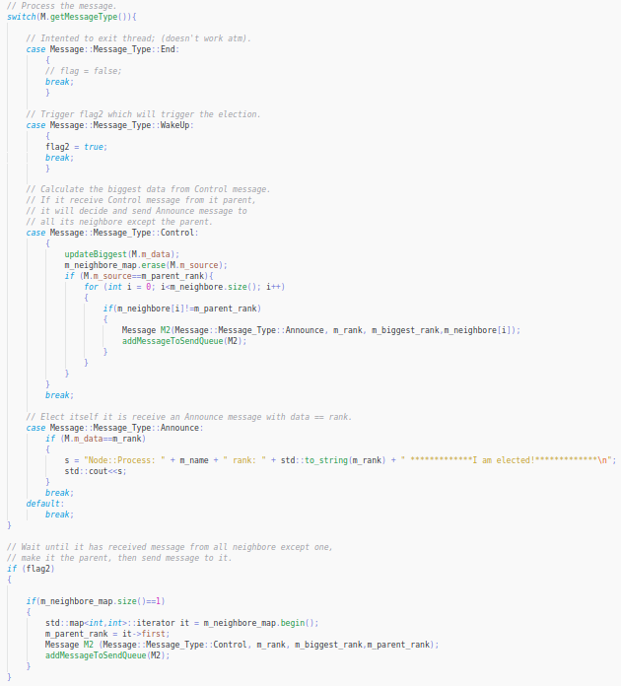

Process Thread

Slide 13
Difficulties
How to send Message structure via MPI.
https://stackoverflow.com/questions/33618937/trouble-understanding-mpi-type-create-struct?fbclid=IwAR1R8zBF697gpufSkTxSOaEa_FeJpEym7UtnKK9WONOZT2ZOyktSEUfl_W0
Designing the 3 threads
Thread
https://en.cppreference.com/w/cpp/thread/condition_variable https://en.cppreference.com/w/cpp/thread/thread https://www.modernescpp.com/index.php/c-core-guidelines-taking-care-of-your-child-thread https://www.youtube.com/watch?v=LL8wkskDlbs&list=PL5jc9xFGsL8E12so1wlMS0r0hTQoJL74M&index=1 https://stackoverflow.com/questions/19463602/compiling-multithread-code-with-g
Single Simple Message Queue
https://www.codeproject.com/Articles/1169105/Cplusplus-std-thread-Event-Loop-with-Message-Queue
Thread locking up and doesn’t terminate correctly.
Times

Slide 14
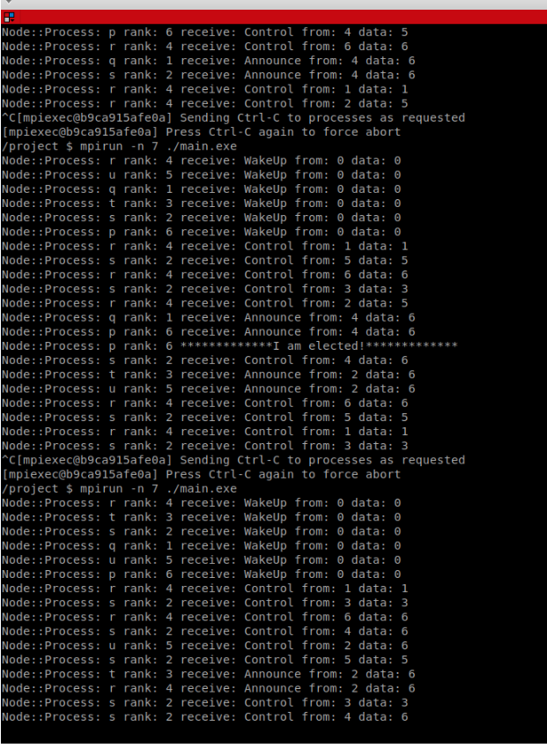
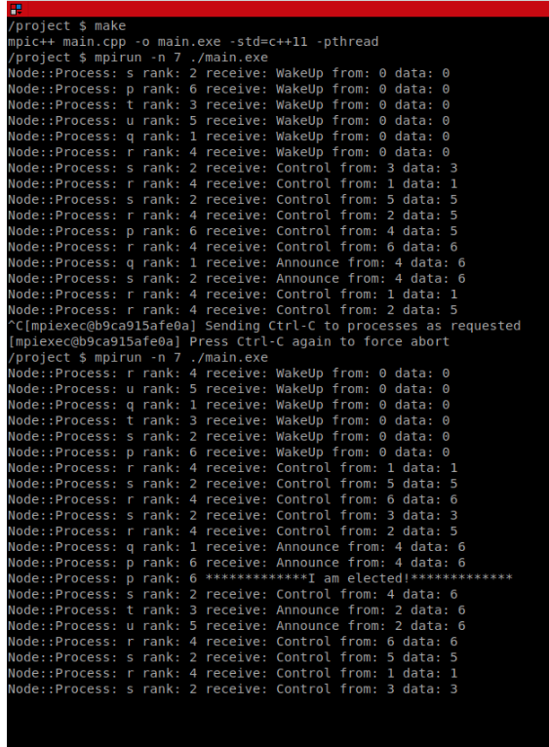
Unsolved/Shortcomings
Threads remains in forever loops (Can’t join the threads).
Don’t see the elected step sometime.

Slide 15
Demo

